Slide 1

Laplace Transform
BIOE 4200

Slide 2
Why use Laplace Transforms?
Find solution to differential equation using algebra
Relationship to Fourier Transform allows easy way to characterize systems
No need for convolution of input and differential equation solution
Useful with multiple processes in system

Slide 3
How to use Laplace
Find differential equations that describe system
Obtain Laplace transform
Perform algebra to solve for output or variable of interest
Apply inverse transform to find solution

Slide 4
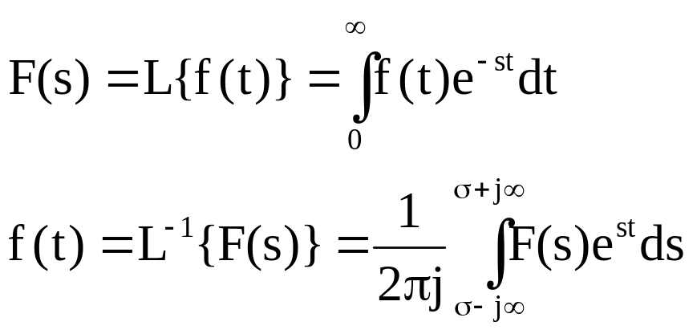
What are Laplace transforms?
t is real, s is complex!
Inverse requires complex analysis to solve
Note “transform”: f(t) → F(s), where t is integrated and s is variable
Conversely F(s) → f(t), t is variable and s is integrated
Assumes f(t) = 0 for all t < 0

Slide 5
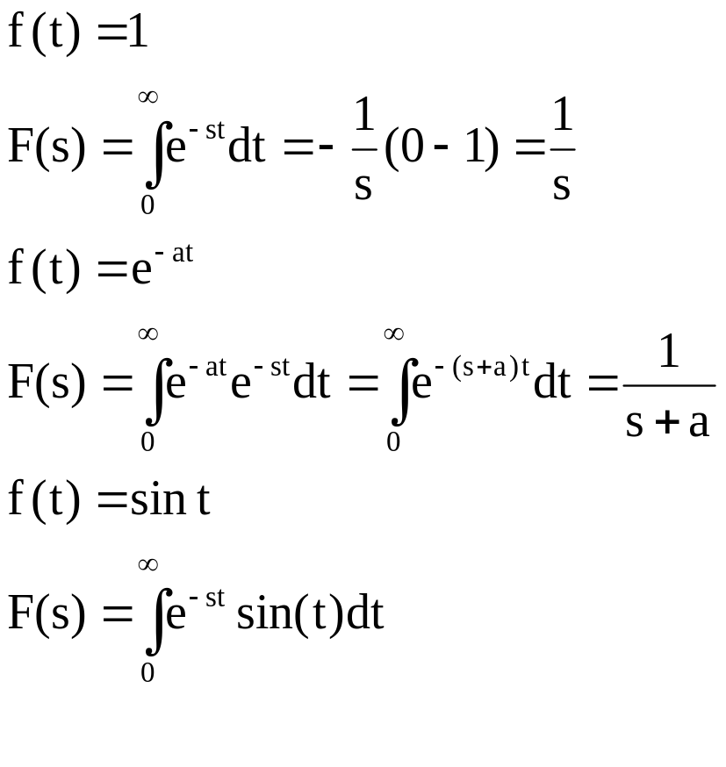
Evaluating F(s) = L{f(t)}
Hard Way – do the integral
let
let
let
Integrate by parts

Slide 6
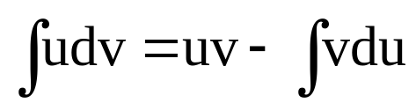
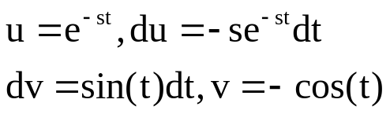
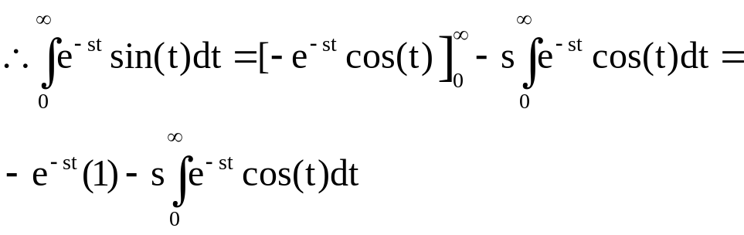
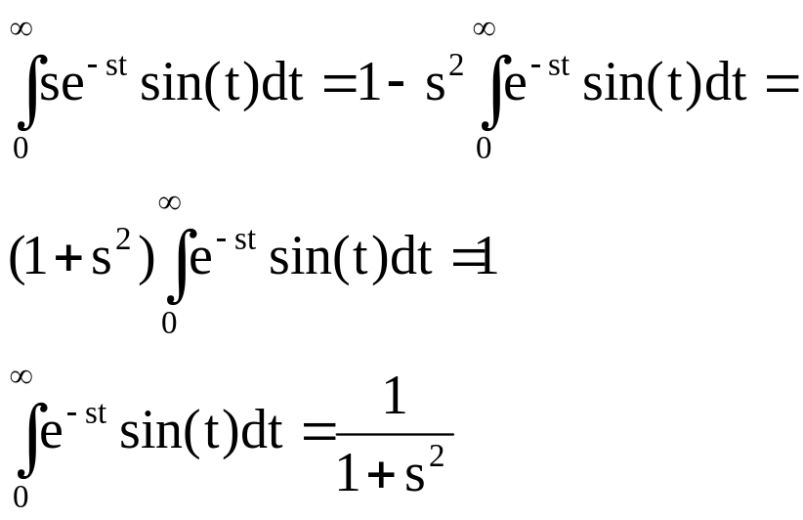
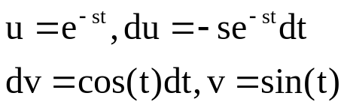
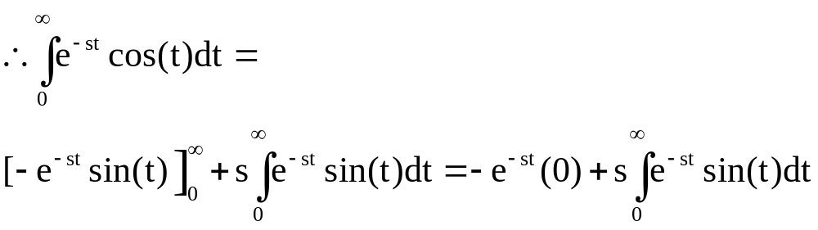
Evaluating F(s)=L{f(t)}- Hard Way
remember
let
Substituting, we get:
let
It only gets worse…

Slide 7
Evaluating F(s) = L{f(t)}
This is the easy way ...
Recognize a few different transforms
See table 2.3 on page 42 in textbook
Or see handout ....
Learn a few different properties
Do a little math

Slide 8
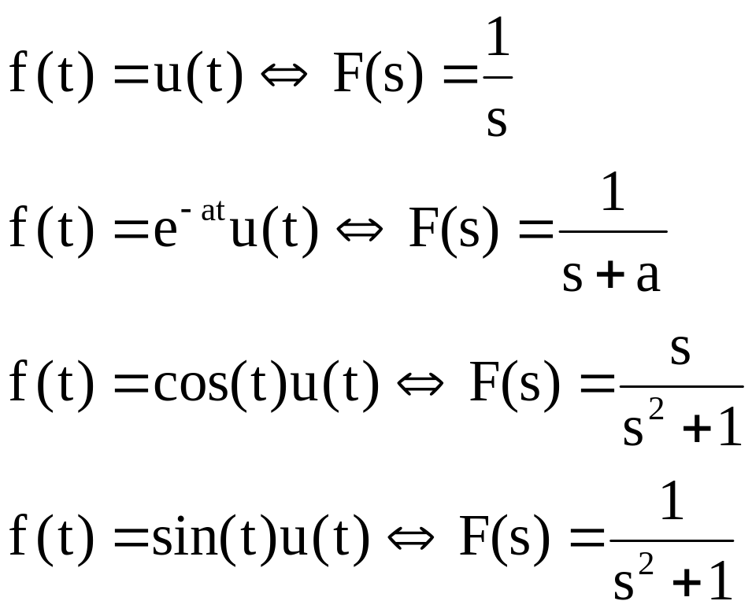
Table of selected Laplace Transforms

Slide 9
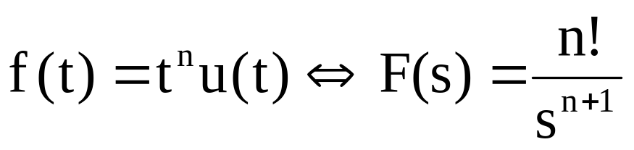
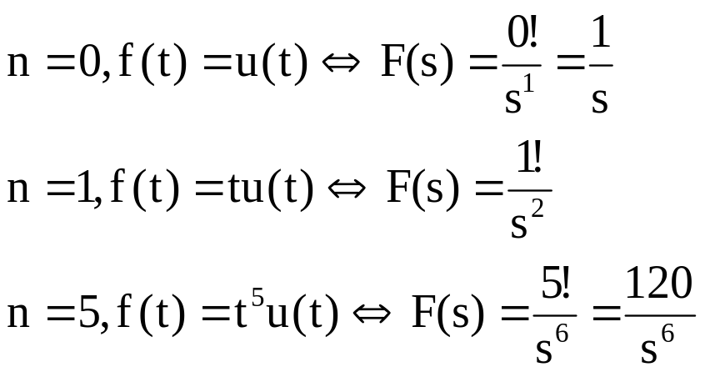
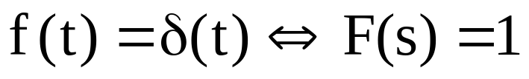
More transforms

Slide 10
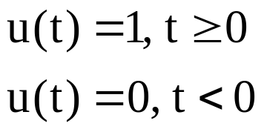
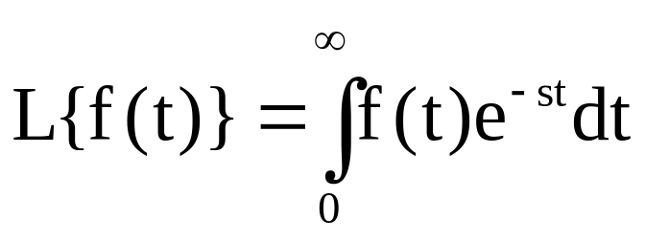
Note on step functions in Laplace
Unit step function definition:
Used in conjunction with f(t) → f(t)u(t) because of Laplace integral limits:

Slide 11
Properties of Laplace Transforms
Linearity
Scaling in time
Time shift
“frequency” or s-plane shift
Multiplication by t^{n}
Integration
Differentiation

Slide 12
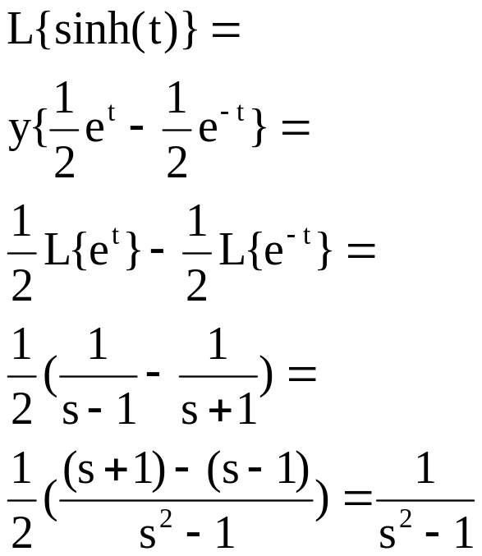
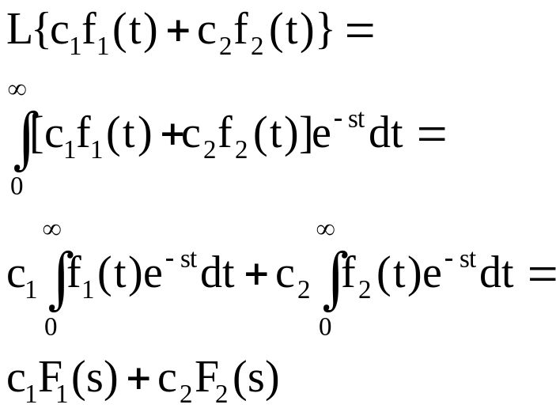
Properties: Linearity
Example :
Proof :

Slide 13
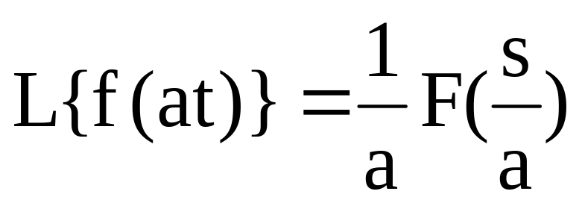
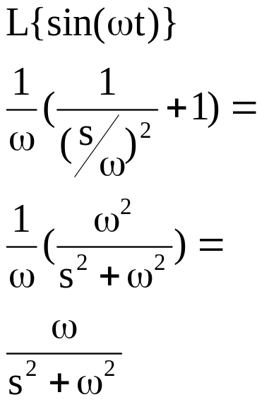
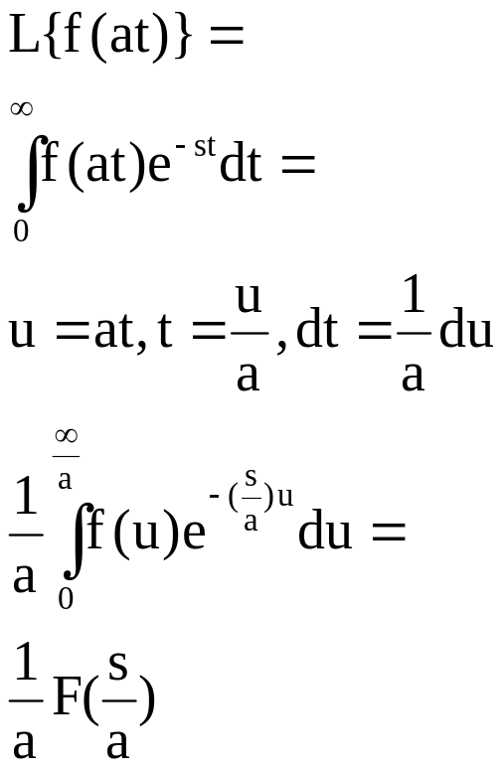
Properties: Scaling in Time
Example :
Proof :
let

Slide 14
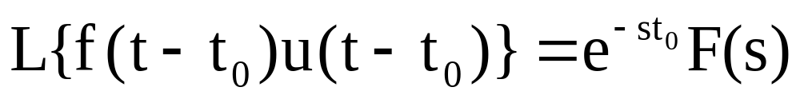
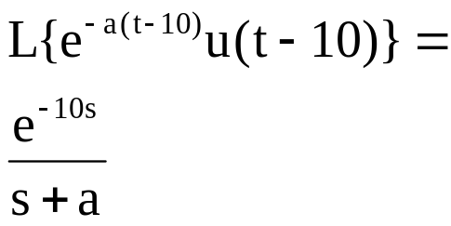
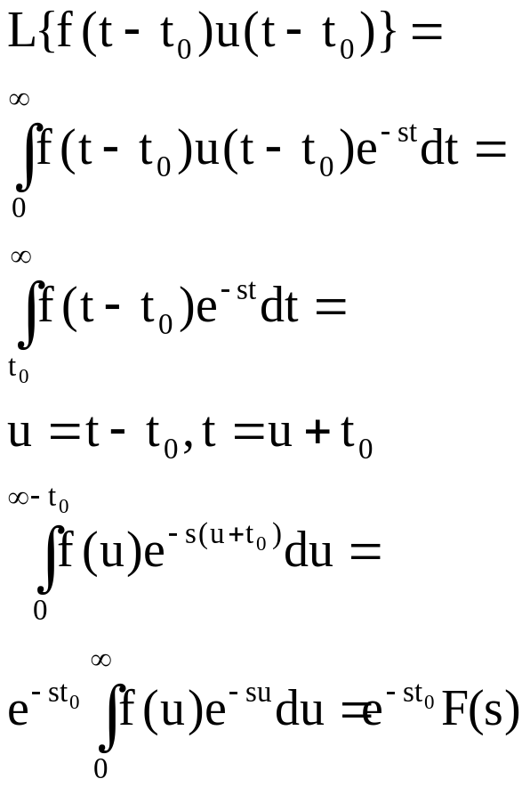
Properties: Time Shift
Example :
Proof :
let

Slide 15
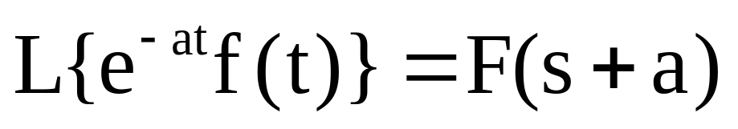
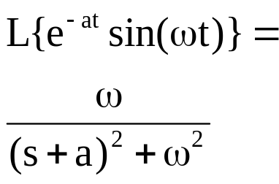
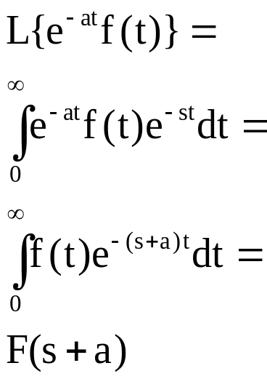
Properties: S-plane (frequency) shift
Example :
Proof :

Slide 16
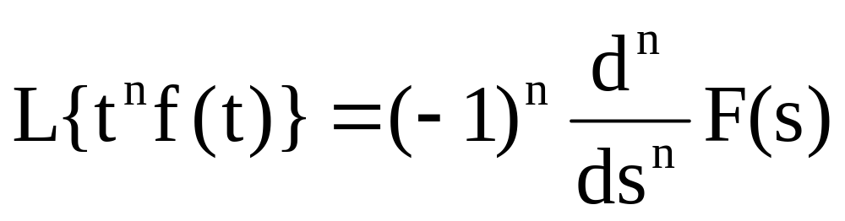
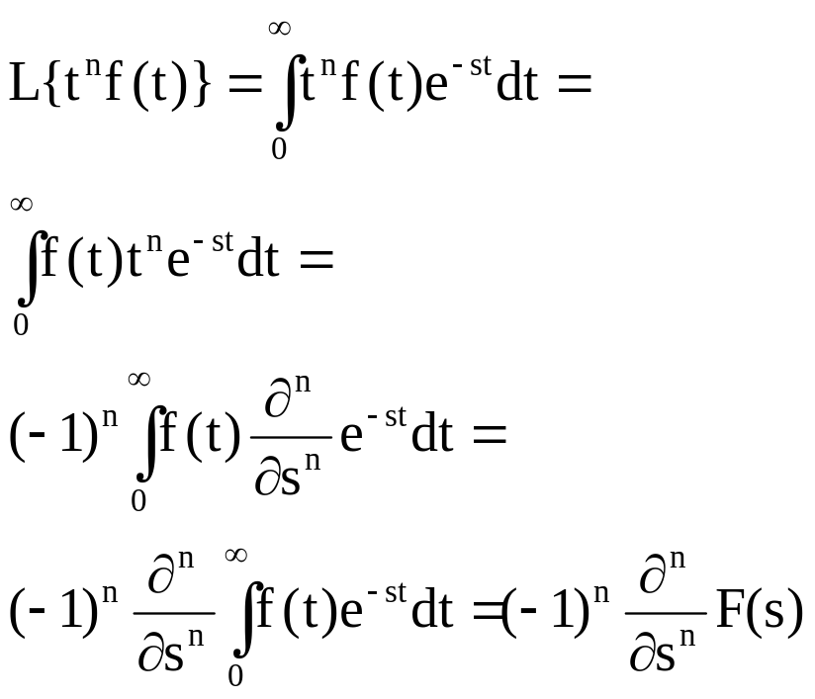
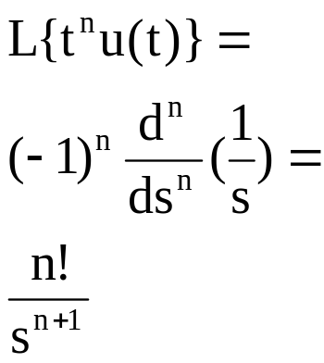
Properties: Multiplication by t^{n}
Example :
Proof :

Slide 17
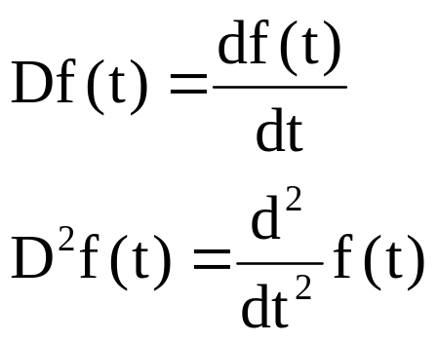
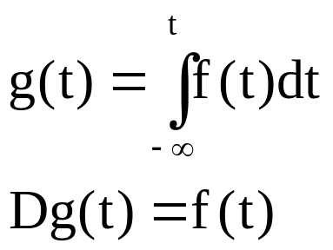
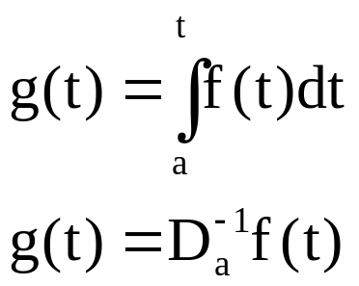
The “D” Operator
Differentiation shorthand
Integration shorthand
if
if
then
then

Slide 18
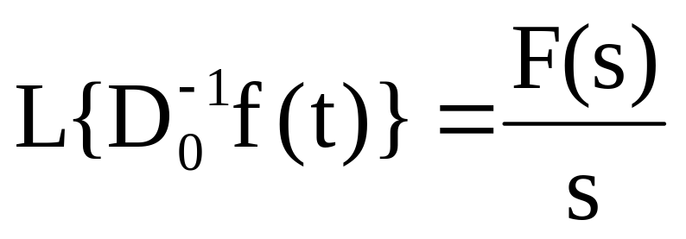
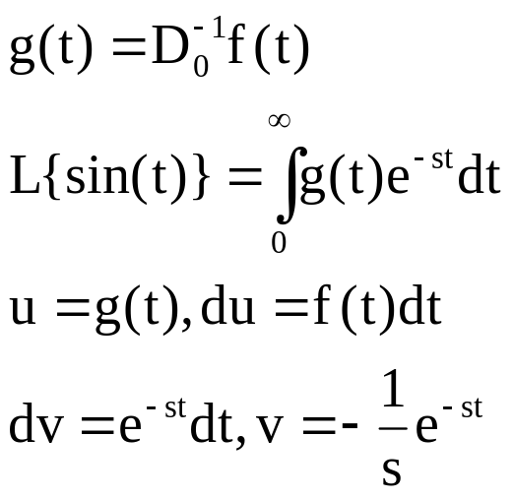
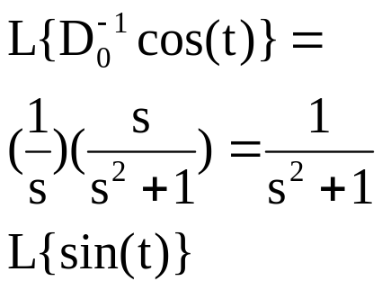
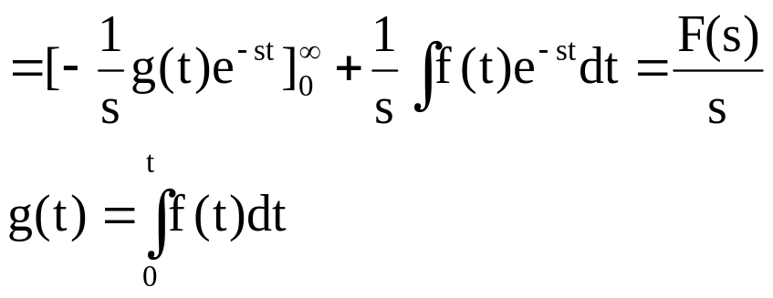
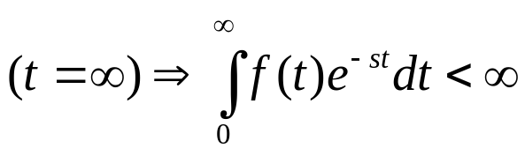
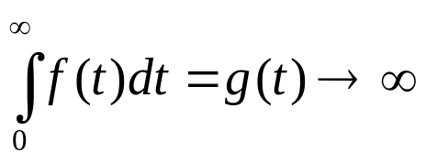

Properties: Integrals
Proof :
Example :
let
If t=0, g(t)=0
for
so
slower than

Slide 19
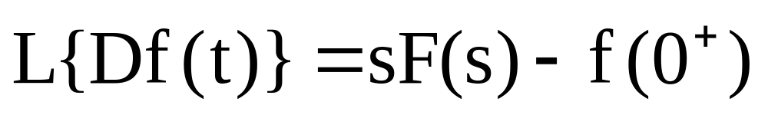
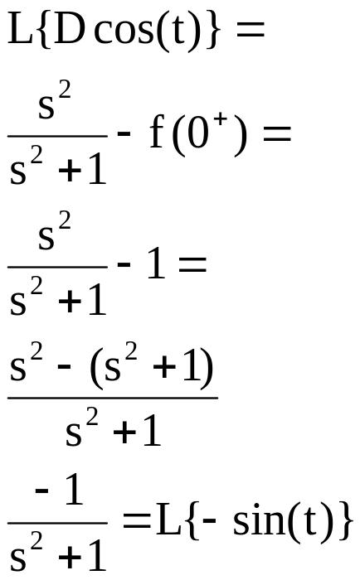
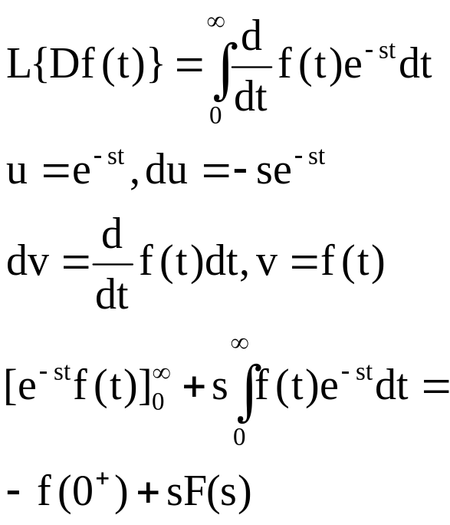
Properties: Derivatives
(this is the big one)
Example :
Proof :
let

Slide 20
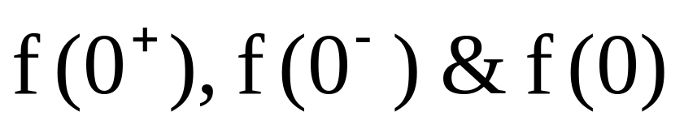
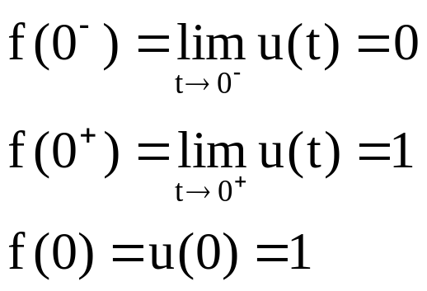
Difference in
The values are only different if f(t) is not continuous @ t=0
Example of discontinuous function: u(t)

Slide 21
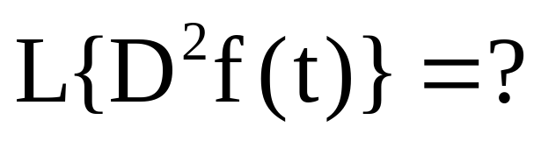
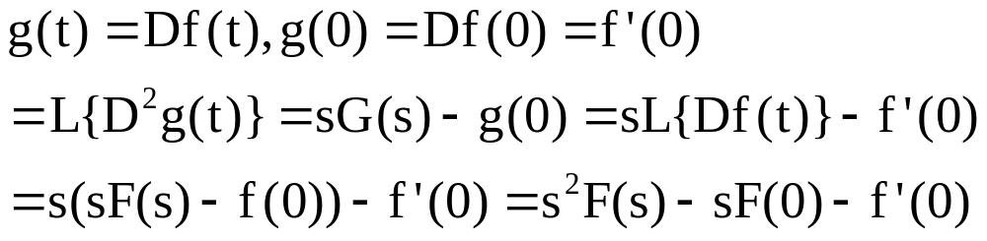


Properties: Nth order derivatives
let
NOTE: to take
you need the value @ t=0 for
called initial conditions!
We will use this to solve differential equations!

Slide 22


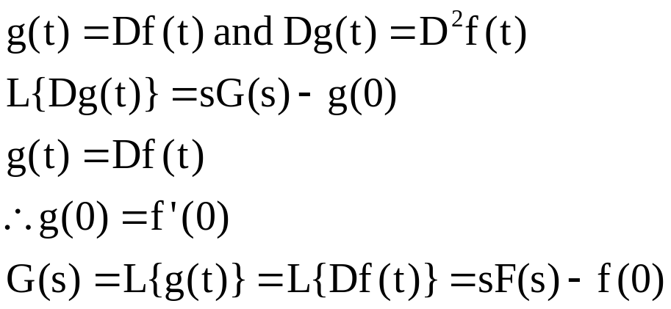

Properties: Nth order derivatives
Start with
Now apply again
let
then
remember
Can repeat for

Slide 23
Relevant Book Sections
Modeling - 2.2
Linear Systems - 2.3, page 38 only
Laplace - 2.4
Transfer functions – 2.5 thru ex 2.4

